Slide 1

Unit- III : HyperText, Multimedia, WWW

Slide 2
HYPERTEXT
This allows a number of different pages to be accessed from the current one.
Typically, hypertext systems incorporate diagrams, photographs and other media as well as text.
Such systems are often known as multimedia or hypermedia systems.
A hypertext system comprises a number of pages and a set of links that are used to connect pages together

Slide 3
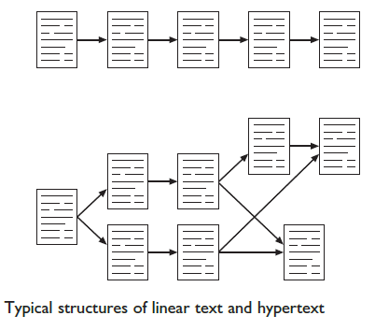

Slide 4
Rich content
animation,
video and audio
Clips
Animation
Animation is the term given to the addition of motion to images, making them move, alter and change in time.
example of animation in an interface is in the form of a clock.
Animate the cursor
work in progress - uses a stick person, apparently doing weightlifting
Non-cursor process indicators (eg. pop-up box)
animated icons used to show the system state

Slide 5
Video and audio
video or audio material as part of hypertext systems whether for education, entertainment or reference.
home-PC systems : video and audio editing
iMac includes a suite for editing video and burning DVDs.

Slide 6
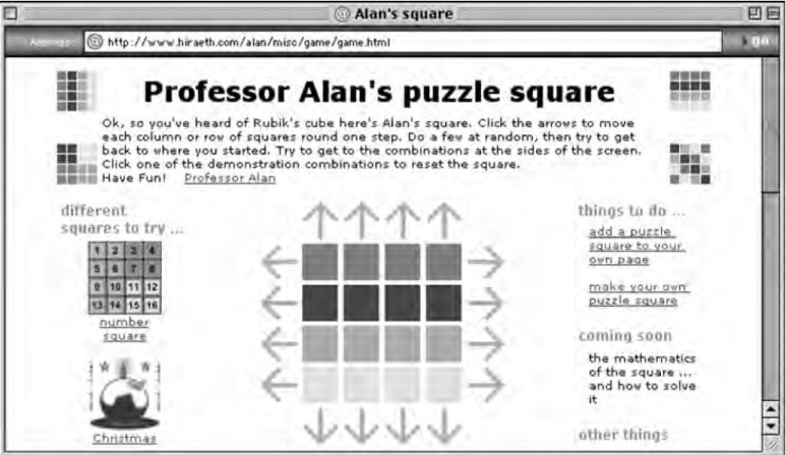
Computation, intelligence and interaction
More interactive hypermedia may contain embedded games or applications.
‘text’ in hypertext suggests passive content under the user’s control

Slide 7
Delivery technology
On the computer
Some hypertexts, in particular help systems, are downloaded or installed permanently on a computer.
media-rich hypertexts containing substantial graphics, video and audio clips it may be impractical to store everything on hard disk.
For highly dynamic material, such as educational media, a special player is installed;
DVD delivered material is interesting as it is not text enriched with video

Slide 8
On the web
world wide web is the best-known multimedia hypertext system of all.
WWW offers a rich environment for the presentation of information.
basic text can be augmented through the use of hypertext links to other documents.
graphics can easily be incorporated as pictures, photographs, icons, page dividing bars, or backgrounds.
active image maps - Pages can also have hypertext links embedded into different regions,

Slide 9
On the web
The web allows the user to browse documents and follow links transparently.
On the move
Mobile phones, PDAs (personal digital assistants), and notebook computers have all increased the demand to have hypermedia available on the move.
The computer is mobile means that location can be used as a key into context-aware hypermedia showing different content depending on location.
GUIDE system, which uses various means to detect location (closest network access point or GPS) and then delivers appropriate tourist information

Slide 10
On the web
PDA
More web-like content can be accessed via WAP (wireless application protocol).
HTTP (hypertext transfer protocol) for the web, gives access to remote servers.
WAP content can be produced as static or dynamic content using a mark-up language called WML(simplified version of HTML)

Slide 11
Application areas
Rapid prototyping tools
HyperCard on Macintosh computers is an example of hypertext systems.
Each card can hold text, diagrams, photographs bitmaps and so on.
hot-spots on the cards allow movement between cards.
HyperCard’s simple scripting language and easy to produce graphical interfaces - rapid prototyping tool for generating interactive systems.
Macromedia Flash and Director are often used to produce dynamic interface mock-ups

Slide 12
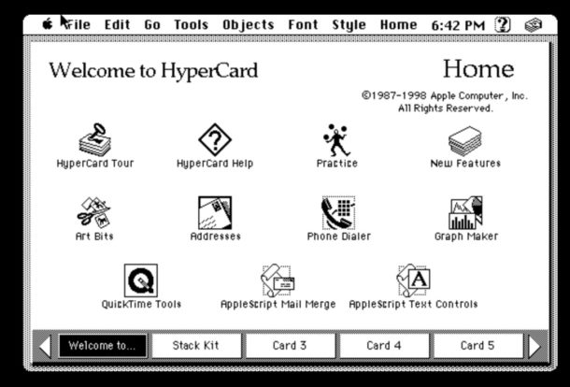
HyperCard

Slide 13
Help and documentation
Help and documentation
Hypermedia systems are ideally suited to online manuals and other help system applications
They allow user-oriented access to the information, and support browsing.
Eg. Sun Guide system, HyperCard help and Microsoft Windows help.
Educational systems are another common application

Slide 14
Education and e-learning
Education and e-learning
Hypertext and hypermedia are used extensively in educational settings.
computer-aided learning (CAL) packages, hypermedia allows a student-controlled learning process.
Brown University to support teaching in subjects as varied as English literature and biology.
The system includes text, diagrams, photos and so on.
Both learners and teachers can add information and links, giving students access to each other’s opinions as well as those of their tutors.

Slide 15
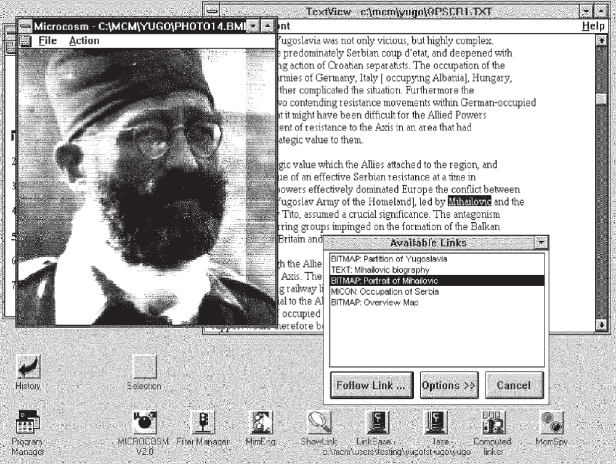
Microcosm
Microcosm is an open hypermedia system - University of Southampton (E &CSE)

Slide 16
Microcosm
Microcosm is able to integrate many different types of media, including other applications, and provides a set of viewing tools to look at text, bitmaps, video, audio and other component information media.
e-learning is sometimes used for learning delivered via the web.

Slide 17
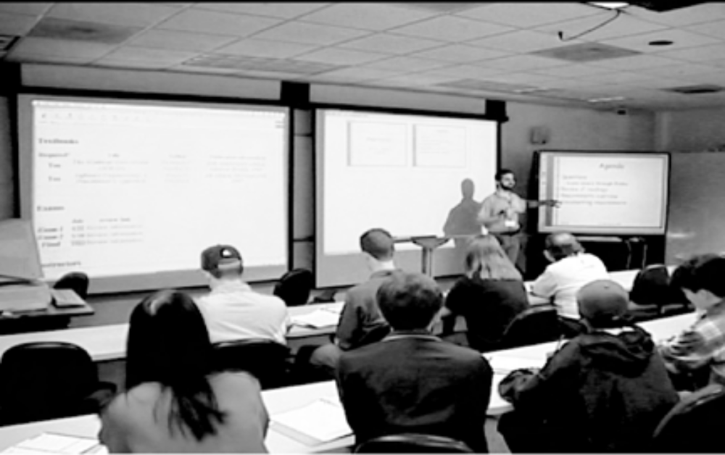
eClass project
eClass project
It records pen strokes on an electronic whiteboard during a lesson.
eClass – recording a lecture

Slide 18
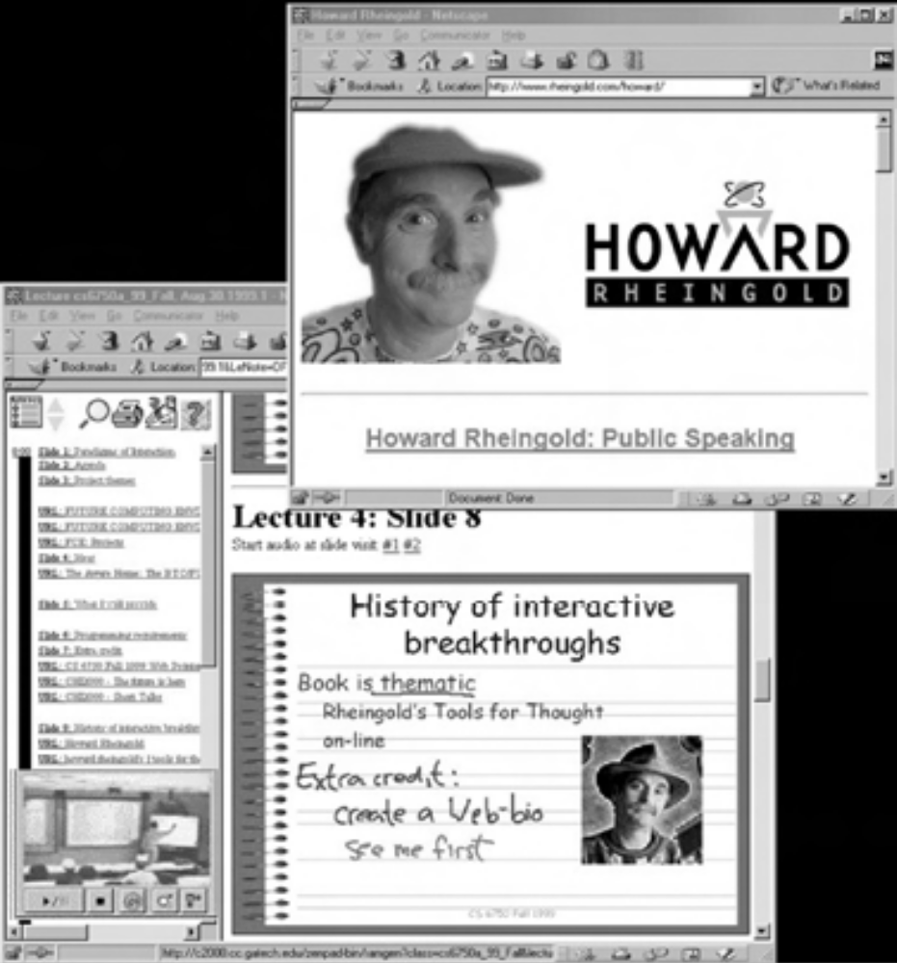
eClass project
eClass – indexed playback on student’s web browser

Slide 19
Collaboration and community
Central platform for collaborative applications and community.
example Yahoo! Groups (groups.yahoo.com) allows mailing lists, shared images (such as family photo albums)
web archives of the mailing list and chat, all accessed through a web interface

Slide 20
E-commerce
online stores such as Amazon or bought from an auction site such as eBay.
Hypertext’s use of hierarchies, links, images and so on, makes it ideal for displaying certain kinds of product
Actual buying and selling requires not only security at the level of the networks, websites, etc., but also trust.

Slide 21
FINDING THINGS
Lost in hyperspace
Hypertext – possibility of easy to lose track of where you are and where you have been.
Designing structure
Good structural design is required
useful in giving a task-oriented, knowledge-orientated breakdown of a hypertext.
Making navigation easier
Provide the user with ‘recommended routes’ through hypertext documents
History, bookmarks and external links
Example - ‘back’ button that allows you to backtrack through previously visited pages

Slide 22
WEB TECHNOLOGY AND ISSUES
The web supports hypertext, graphics, sound and movies, and, to structure and describe the information, uses a language called HTML or XML.
HTML allows hypertext links, images, sounds and movies to be embedded into text.
Browser
very first graphical browser Mosaic,
Netscape Navigator, Microsoft Internet Explorer and Opera.

Slide 23
WWW
Web servers and web clients
The pages are stored on web servers that may be on a company’s own premises or in special data centers.
PC running the web browser, is called a client

Slide 24
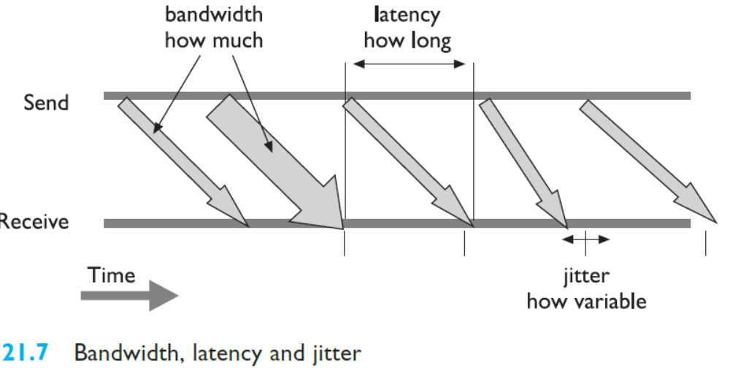
WWW
Network issues
Network capacity is called bandwidth.
For example, a typical modem speed is 56 kbs – that is 56 kilobits per second.

Slide 25
WWW
Variability in the latency is called jitter
Internet protocols are lossy

Slide 26
WWW-Static Web Content
The message and the medium
poor design can mean that excellent material is never seen by potential readers, as they have become bored, or intolerant of the medium, or confused, or for a host of other reasons have aborted their attempts to download and view the information.

Slide 27
WWW
Text
fonts - a standard font and a typewriter font (e.g. courier)
Arial, Verdana or Comic Sans are available on most web platforms
Cascading style sheets (CSS) allow you to specify fonts, line spacing, size,
way to styles in a word processor or DTP package.
Color
red is associated with danger and anger,
green is regarded as go, or safe.
Blue can be a cool color.
orange a warm one.

Slide 28
WWW
Links
colored text
text-placing options: text can be left or right justified, or centered.
Ordered and unordered lists
dynamic HTML’ (DHTML), - layers or ‘div
The word ‘dynamic’ is used because these can then be controlled using JavaScript to produce various animated effects.

Slide 29
WWW - Graphics
Using graphics
Graphical images take longer to load than text, and this may become a problem
For graphics, one pixel may use 8 bits to represent its color:
Most browsers support caching, in which graphics are downloaded once and temporarily stored on the user’s local machine.

Slide 30

WWW - Icons
Icons often appear on web pages
They are either visual cues, associating some small picture with different parts of the text.
WIMP interface
This page still under construction
Graphics and color

Slide 31
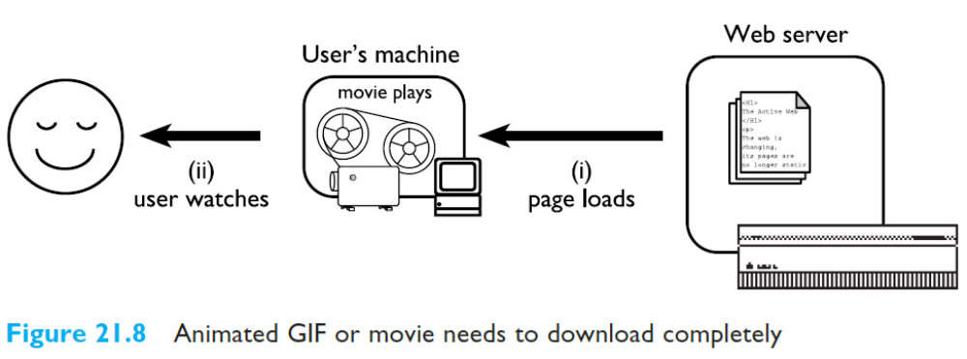
WWW - Movies and sound
Streaming media over the internet, such as RealVideo, RealAudio and CuSeeMe, allow potentially unlimited sources.

Slide 32
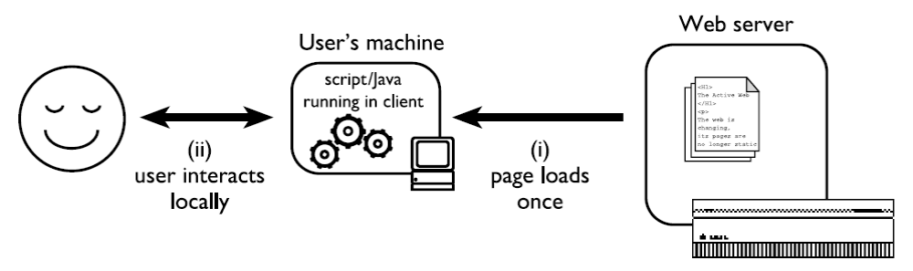
WWW - Dynamic Web Content
Fixed content – local interaction and changing views

Slide 33
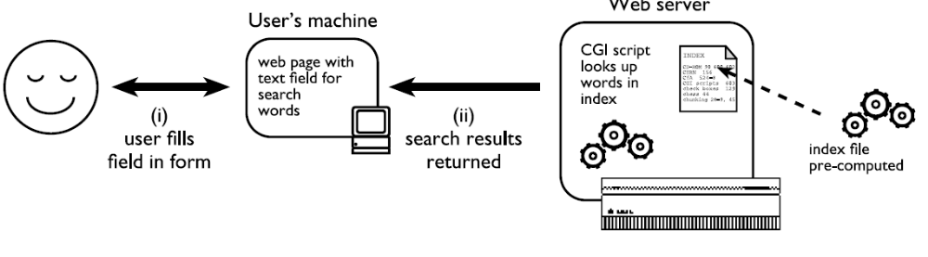
WWW - Dynamic Web Content

Slide 34
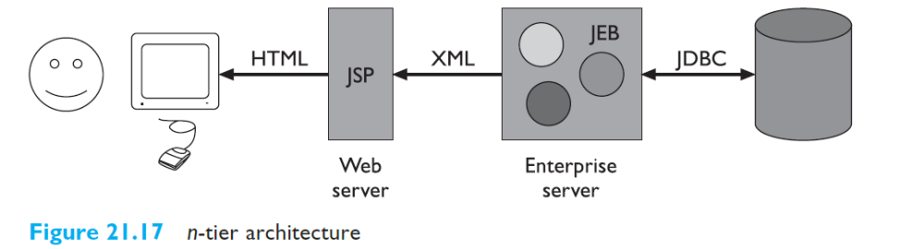
WWW - Dynamic Web Content

